Slide 1
Heap Structure

Slide 2
Heap
Heap data structure is a complete binary tree that satisfies the heap property, where any given node is
always greater than its child node/s and the key to the root node is the largest among all other nodes. This property is also called max heap property.
always smaller than the child node/s and the key to the root node is the smallest among all other nodes. This property is also called min heap property.

Slide 3
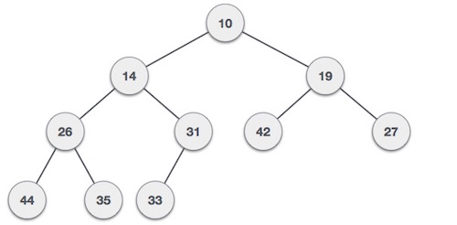
Heap
Min-Heap − Where the value of the root node is less than or equal to either of its children.
Notes:
heapSort() – This function helps construct the max heap initially for use. Once done, every root element is extracted and sent to the end of the array. Once done, the max heap is reconstructed from the root. The root is again extracted and sent to the end of the array, and hence the process continues.
heapify() – This function is the building block of the heap sort algorithm. This function determines the maximum from the element being examined as the root and its two children. If the maximum is among the children of the root, the root and its child are swapped. This process is then repeated for the new root. When the maximum element in the array is found (such that its children are smaller than it) the function stops. For the node at index i, the left child is at index 2 * i + 1, and the right child is at index 2 * i + 1. (indexing in an array starts from 0, so the root is at 0).

Slide 4
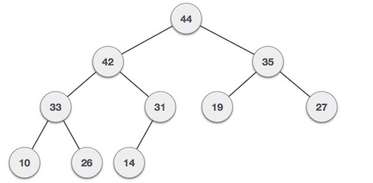
Heap
Max-Heap − Where the value of the root node is greater than or
equal to either of its children.

Slide 5
Heap
In Min Heap construction algorithm, we expect the value of the parent
node to be less than that of the child node.

Slide 6
Heap
The number of operations required depends only on the number of levels the new element
must rise to satisfy the heap property. Thus, the insertion operation has a worst-case time
complexity of O(log n). For a random heap, and for repeated insertions, the insertion
operation has an average-case complexity of O(1).

